Slide 1
Build the Enlightened Enterprise
An overview of the JBoss BRMS
& JBoss DV integration demo
Powered by Red Hat JBoss Middleware:
JBoss BRMS
JBoss DV

Slide 2
Solution - Red Hat JBoss BRMS

Slide 3
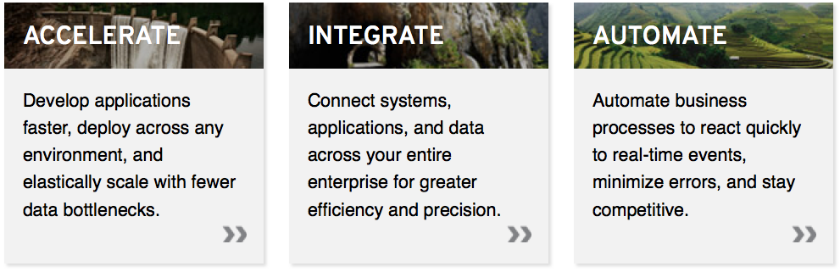
Innovate faster, in a smarter way
A family of a lightweight, enterprise-grade products that are ideal for open hybrid cloud environments.
Red Hat JBoss BRMS
Notes:
Arrow to your own product

Slide 4
The Business Rules Solution
AHA!
Rule
Repository
1. Separate the business rules
from the applications
Express rules in terms that the business can readily understand - visibility
Empower business and IT experts
to collaborate - agility
4. Automate all the rules - consistency

Slide 5
BRMS - Technology Overview

Slide 6

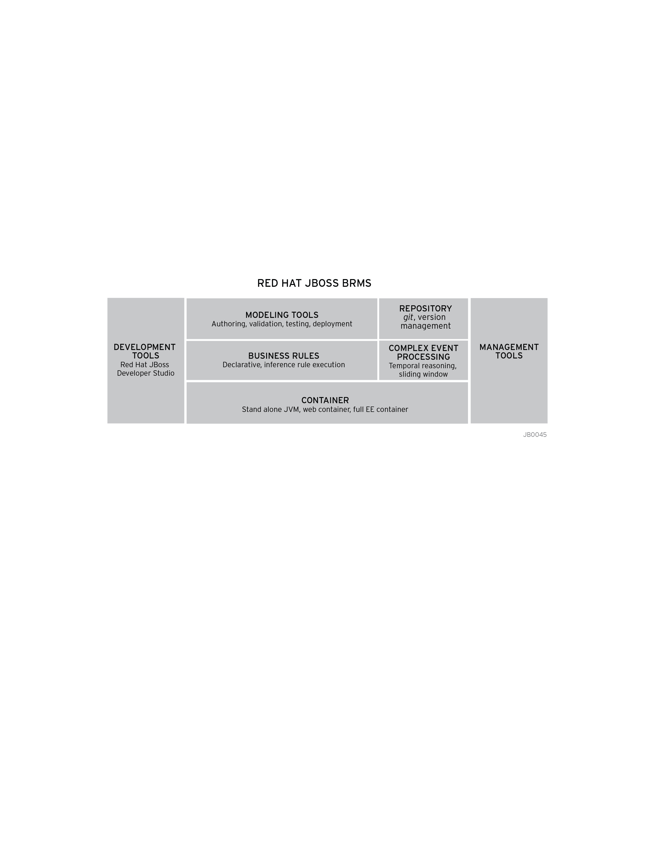
A single, integrated, certified distribution for Business Rules Management and Complex Event Processing, based on open source community projects:

Slide 7

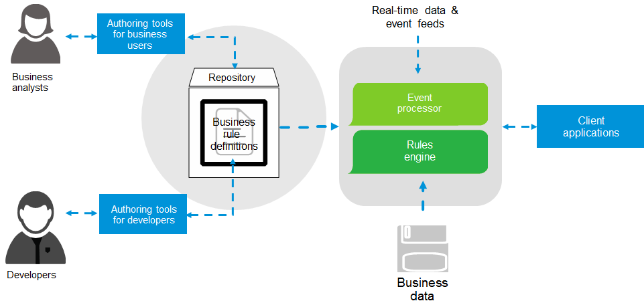
Components

Slide 8
DV - Technology Overview

Slide 9
JBoss BRMS + DV

Slide 10
Build the Enlightened Enterprise
For more information, please visit: http://www.jboss.org/products/brms http://www.jboss.org/products/datavirt
Demo available at: http://github.com/kpeeples/dv-brms-integration-demo

